Slide 1
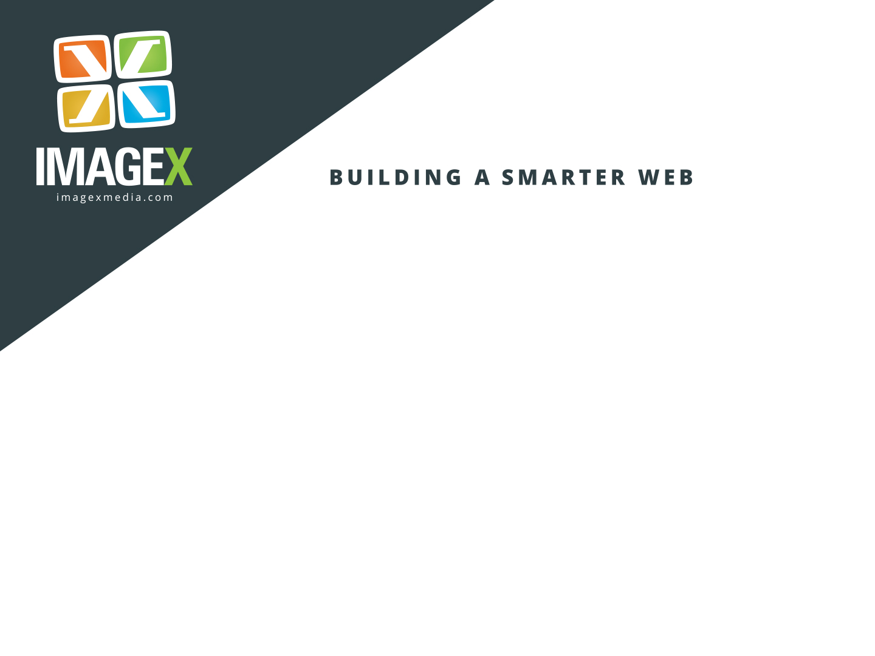
The Agile Drupalist
Methodologies & Techniques for Running Effective Drupal Projects
By Adrian “AJ” Jones (Canuckaholic)
Notes:
COVER 1 – A sample for the cover

Slide 2

Agenda
What We Will be Talking About Today…
Introductions
What kind of processes are out there?
The “Iron Triangle” of project management
What does it mean to be “Agile”?
Why be Agile?
The Agile Drupalist
Mapping the Project Life Cycle
Case Study
Notes:
CONTENT 1 – A sample for the content page

Slide 3
Introductions
A Little Bit About Me…
User Experience Designer. Business Analyst. Content Strategist. Information Architect. Interaction Designer.
Passionate about making better digital experiences.
My Experience in Agile:
Certified Scrum Product Owner
Have worked on large-scale, big-budget Agile projects:
Kobo Instant Reader HTML5 App
New York State Education Department
Stanford University School of Engineering
Masters degree in Interactive Arts & Technology, where I was first introduced to the Agile philosophy.
Notes:
An interesting thing about me is that I used to work for the Vancouver Canucks, and that’s where my Drupal.org “Canuckaholic” username came from.

Slide 4

Introductions
A Little Bit About YOU!
Who Are You?
Web Dev?
Front-end Dev?
Back-end Dev?
Drupal Dev?
Web Designer?
Information Architect?
Business Analyst?
UX Designer?
Project Manager?
All of the above?
Notes:
An interesting thing about me is that I used to work for the Vancouver Canucks, and that’s where my Drupal.org “Canuckaholic” username came from.

Slide 5
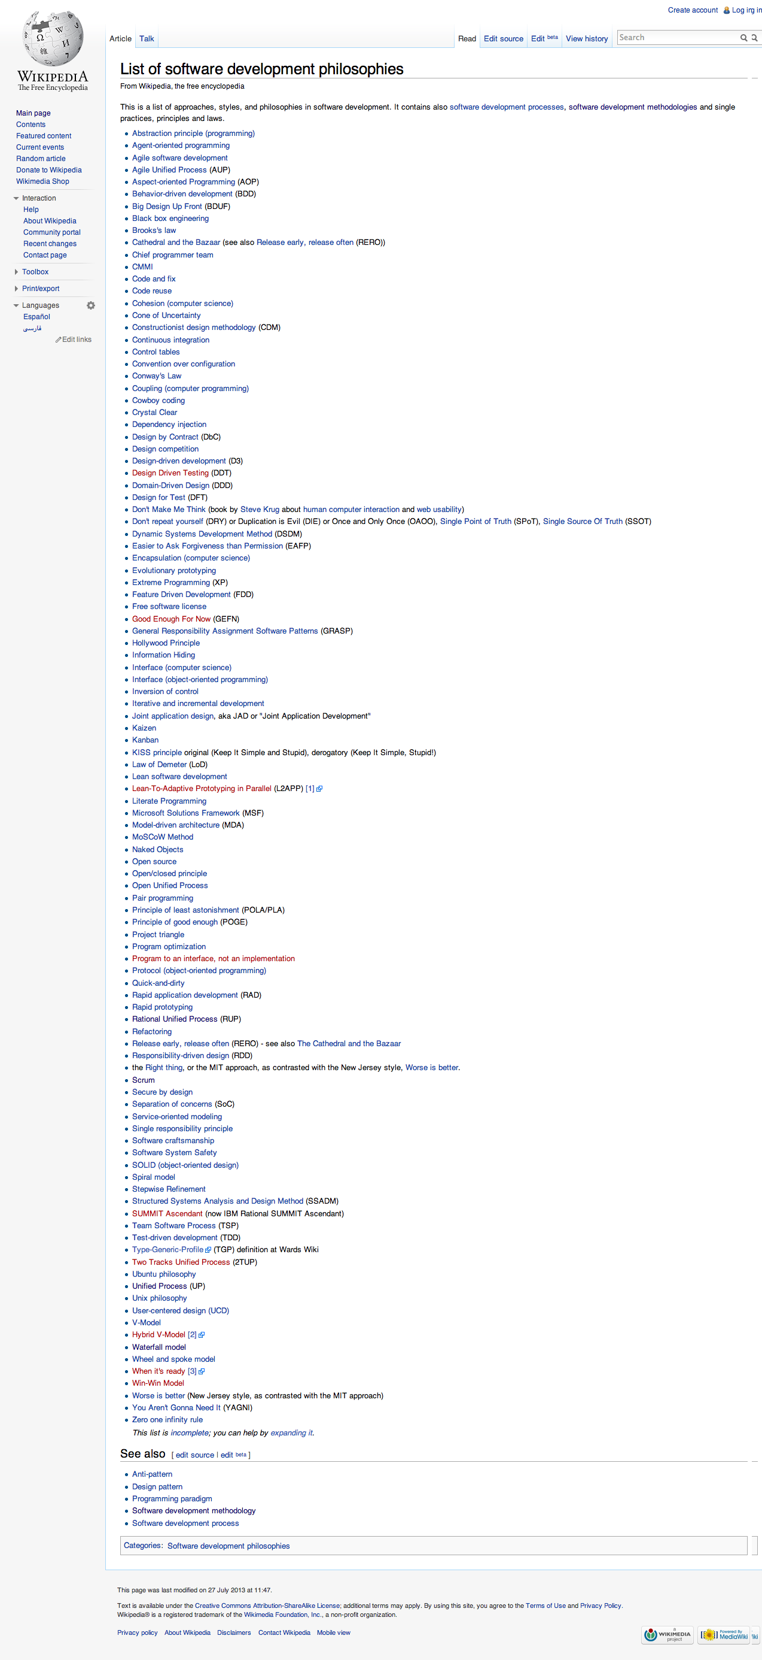
What’s Out There?
The Answer? A lot.
Waterfall
Agile
Scrum
Kanban
XP
Lean
Rational Unified Process (RUP)
Microsoft Solutions Framework (MSF)
Rapid Application Development (RAD)
Notes:
Ask the audience what methodologies they use.
Today I’m going to talk about just one of these, albeit an increasing popular one: Agile, and more specifically Scrum.

Slide 6
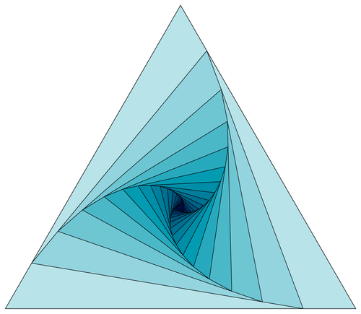
The Iron Triangle
Of Project Management
Okay… Let’s see how much we know…

Slide 7
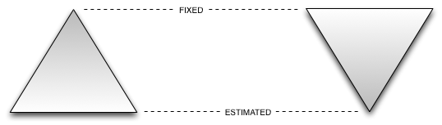
The 3 Points of the Iron Triangle Are:
Scope/Features/Functionality
Budget/Resources
Time/Schedule

Slide 8
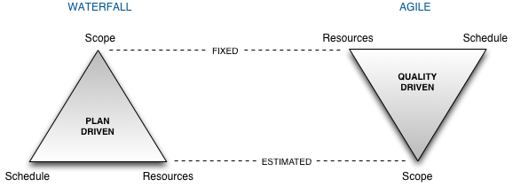
How I Would Draw It…

Slide 9
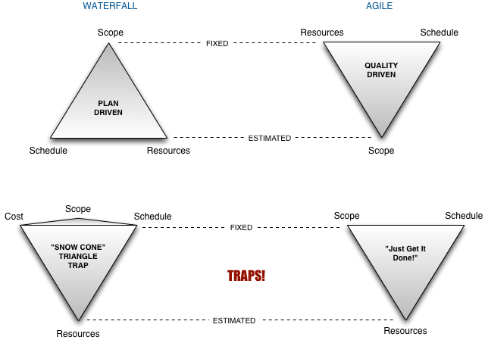
Some Traps

Slide 10
What is “Agile”?
Agile is NOT a Methodology… no really.
Agile (capital “A”) is a philosophy. It’s a way of thinking.
“Agile software development is a group of software development methods based on iterative and incremental development, where requirements and solutions evolve through collaboration between self-organizing, cross-functional teams.“ (Wikipedia)
Scrum is an example of a methodology under the Agile philosophy of software development.
Notes:
CONTENT 1 – A sample for the content page

Slide 11
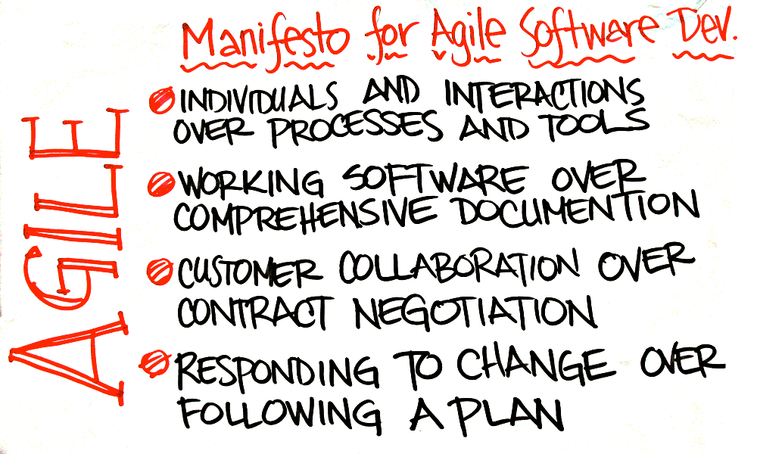
The Agile Manifesto
Consists of Only 4 Principles…
Notes:
“That is, while there is value in the items on the right, we value the items on the left more.”
This is real easy to say, but let me tell you, this is NOT easy to do.

Slide 12
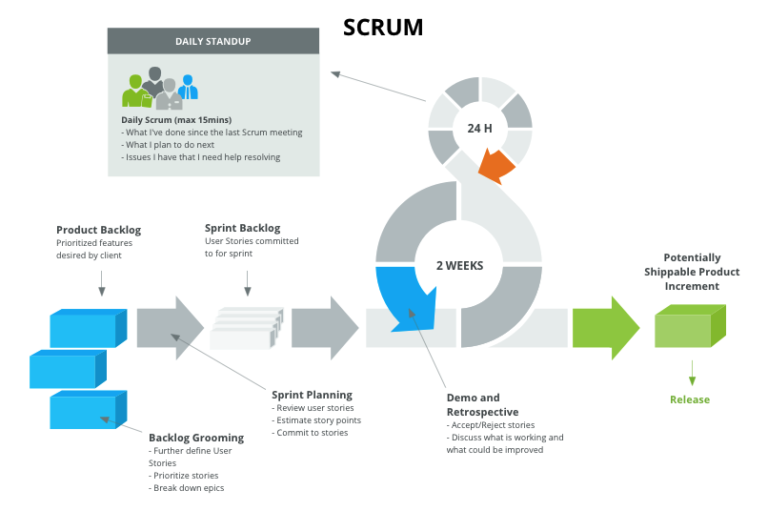
The Scrum Process
Standup. Groom. Plan. Demo. Release.
Notes:
“That is, while there is value in the items on the right, we value the items on the left more.”
This is real easy to say, but let me tell you, this is NOT easy to do.

Slide 13
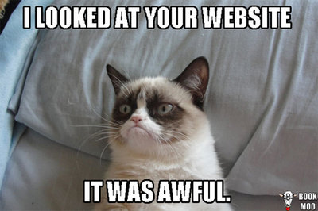
Why be Agile?
What are the benefits and why should I bother?
Because…
Notes:
CONTENT 1 – A sample for the content page

Slide 14
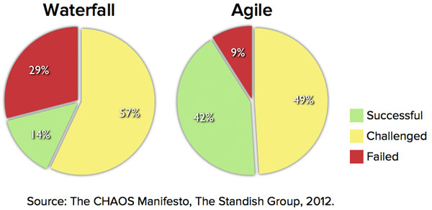
Why be Agile?
What are the benefits and why should I bother?
Because research shows that you have a greater chance of success with Agile methods.
Notes:
CONTENT 1 – A sample for the content page

Slide 15
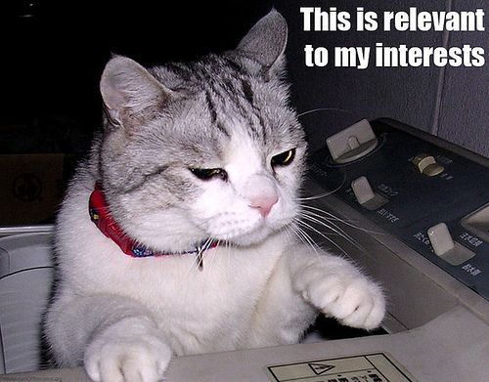
Why be Agile?
What are the benefits and why should I bother?
Some Reasons to go Agile:
Easier, and less costly, to adapt to change
Often better than Waterfall at managing risk
Necessitates more involvement from stakeholders
Developers feel more ownership. Empowered.
Better chance of building something useful
Quality-driven focus
Greater transparency. Visibility.
Quicker feedback from end-users
It’s actually kind of fun!
…?
Notes:
CONTENT 1 – A sample for the content page

Slide 16
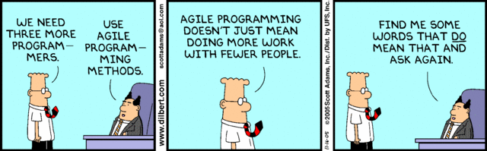
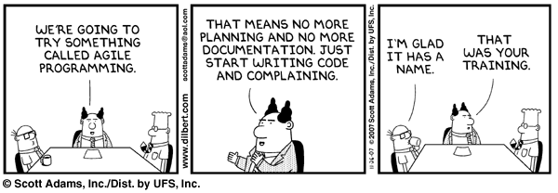
Who Is Using Agile?
Scrum… Kanban…???
Notes:
CONTENT 1 – A sample for the content page

Slide 17
The Agile Drupalist
Flexible, Adaptable… like a Gymnast.
Okay all this theory is well and good, but how does this apply to Drupal development?
Drupal Strengths for Agile Development:
Contrib modules help developers respond to changing requirements
Drupal is a good tool for HTML prototyping
Drupal works well with versioning (e.g. Git) and Continuous Integration (e.g. Jenkins), both of which are great for Agile development.
…?
Notes:
CONTENT 1 – A sample for the content page

Slide 18
The Agile Drupalist
Flexible, Adaptable… like a Gymnast.
An important point to note is that most often a (medium to large) Drupal website is going to be built by a web services agency.
A Typical Agency Project Life Cycle:
Information Discovery
Requirements Analysis & Information Architecture
Design
Development
Content Creation (i.e. adding content to the site)
Quality Assurance
Deployment/Launch
Maintenance
Notes:
CONTENT 1 – A sample for the content page

Slide 19
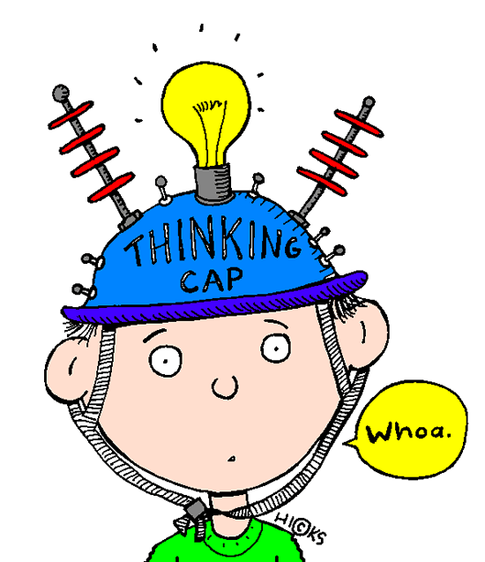
The Truth
You Can’t Handle the Truth!
If you are an agency…
and you are developing in Drupal…
pure Agile is probably not the best option.
Notes:
CONTENT 1 – A sample for the content page

Slide 20
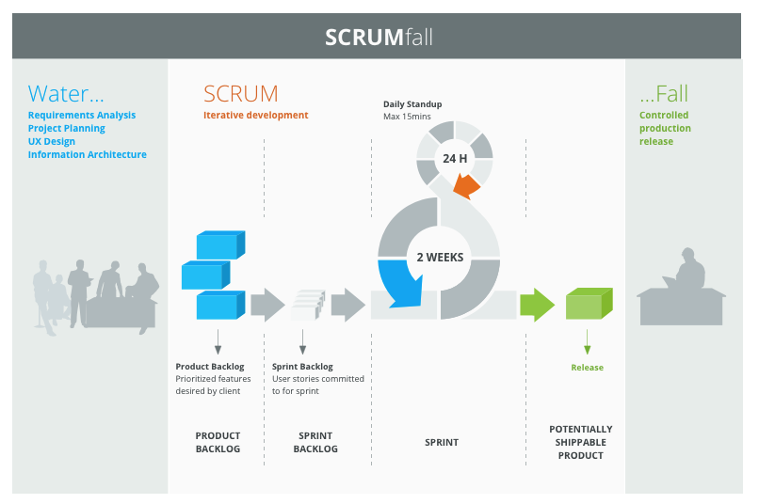
Scrumfall
No, it’s not the title of the next James Bond movie…
Scrumfall is a “hybrid” of Waterfall and Scrum methodologies, often employed when there needs to be more certainty around the project scope.
Notes:
CONTENT 1 – A sample for the content page

Slide 21
Information Discovery
Phase #1 of 8
Waterfall Tasks Agile Tasks
Documenting: Project plan Business requirements Schedule Risk analysis Scope definition | Iterating: Brainstorming High-level requirements (i.e. vision, mission statement) Elevator pitch Product box
Notes:
CONTENT 1 – A sample for the content page

Slide 22
Requirements Analysis
Phase #2 of 8
Waterfall Tasks Agile Tasks
Documenting: Functional requirements Content Types Taxonomy Sitemap Non-functional requirements User requirements Roles & Permissions | Iterating: Low fidelity wireframes Paper prototypes Affinity diagramming Use Cases Process Flow Diagrams UML Models
Notes:
Agiles tasks feed into Waterfall tasks

Slide 23
Design
Phase #3 of 8
Waterfall Tasks Agile Tasks
Documenting: Style and branding guide Visual mockups | Iterating: Higher fidelity wireframes including responsive layouts Interactive designs
Notes:
Agiles tasks feed into Waterfall tasks

Slide 24
Development
Phase #4 of 8
Waterfall Tasks Agile Tasks
Limited: Building the initial architecture and infrastructure. Maybe some of the groundwork for the high-level functional requirements. Be careful of changing Content Types or Vocabularies! | Breaking down epics into user stories. Building out all the site features, modules, functionality in sprints by completing user stories. Using the Features module to get things (i.e. entities) out of the database and into code so it can be versioned (e.g. Git).
Notes:
Agiles tasks feed into Waterfall tasks

Slide 25
Content Creation
Phase #5 of 8
Waterfall Tasks Agile Tasks
Deciding at a high level what kind of content is going to be added to the site. | Adding the actual content during sprints as features are developed.
Notes:
Agiles tasks feed into Waterfall tasks

Slide 26
Quality Assurance
Phase #6 of 8
Waterfall Tasks Agile Tasks
Matching finished site or site components with the functional requirements and overarching architecture. Regression testing. | Each user story should go through its own set of QA tests to satisfy the Definition of Done. Product Owner reviews Acceptance Criteria and accepts or rejects user stories.
Notes:
Agiles tasks feed into Waterfall tasks

Slide 27
Deployment/Launch
Phase #7 of 8
Waterfall Tasks Agile Tasks
Checklist for launch. | Not as effective.
Notes:
Agiles tasks feed into Waterfall tasks

Slide 28
Maintenance
Phase #8 of 8
Waterfall Tasks Agile Tasks
No preference. | No preference.
Notes:
Agiles tasks feed into Waterfall tasks

Slide 29
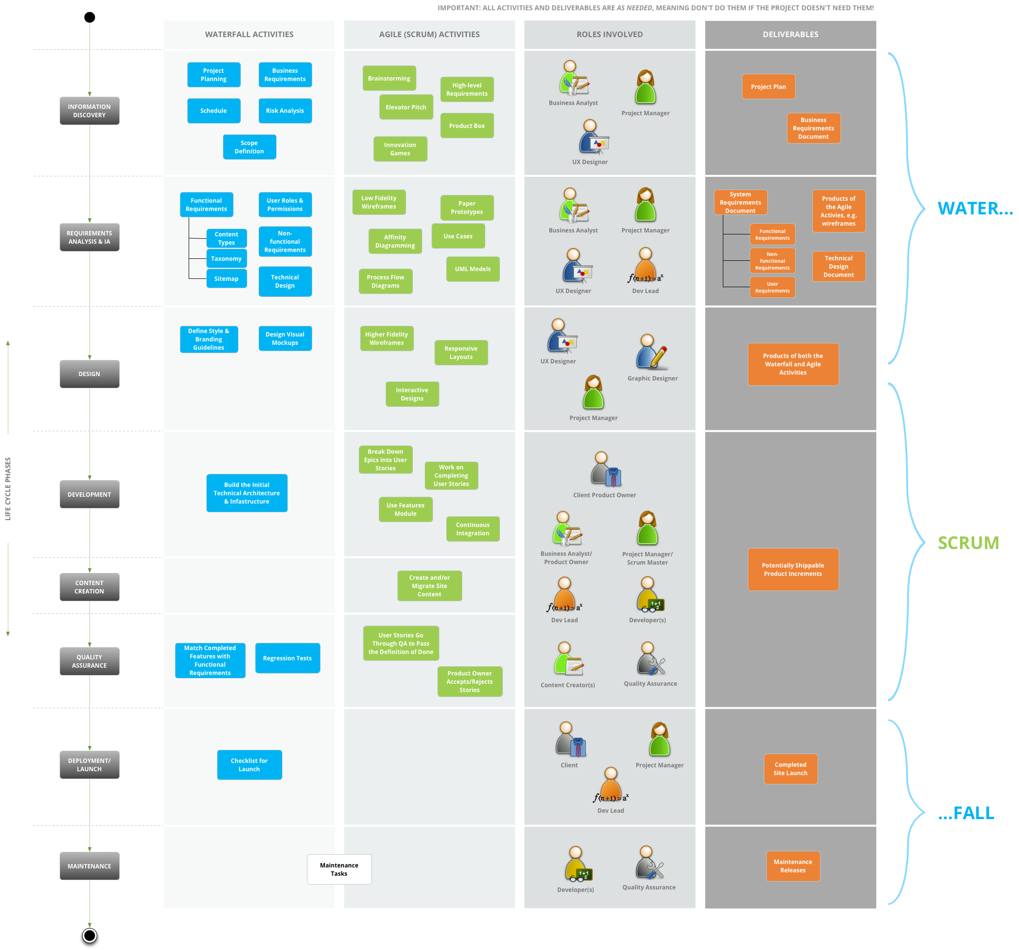
Putting It All Together
Notes:
Agiles tasks feed into Waterfall tasks

Slide 30
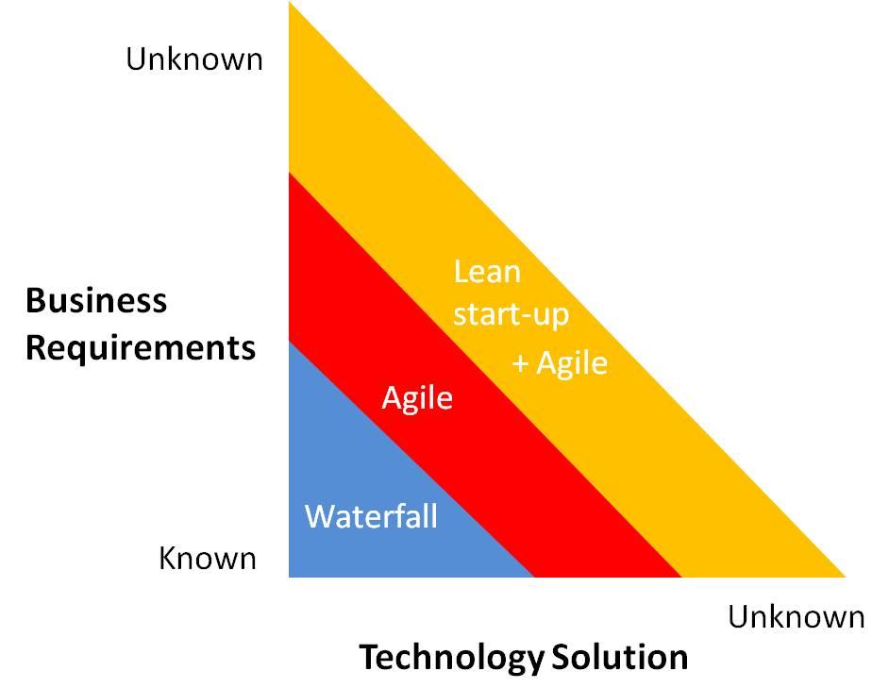
Things to Consider
To Scrum, or not to Scrum, that is the question
Fixed budget? Fixed scope? You might want to be more Waterfall-ish.
Is there uncertainty and the end goal isn’t clear at the start? Is there a high likelihood of changing requirements? Agile can often get you a better result.
Notes:
Any methodology can be really good or really bad. It depends on context, such as the type of client, budget, type of requirements, etc.

Slide 31

Real World Case Study
Putting yer money where yer mouth is
Redesigning Stanford University’s School of Engineering website…
Notes:
CONTENT 1 – A sample for the content page

Slide 32
Case Study - Stanford
Waterfall Activities…
Business Requirements Doc System Requirements Doc
Document Goals & Objectives: Allow users to easily navigate between the main site and the different department sites in an integrated experience. Provide easily accessible information to current students about graduation processes. | Functional Requirements: FR-NCR-01: Display Latest News on Homepage. FR-FSC-01: Faculty & Staff Directory Page. FR-APR-01: Academic Programs Landing Page.
Notes:
CONTENT 1 – A sample for the content page

Slide 33
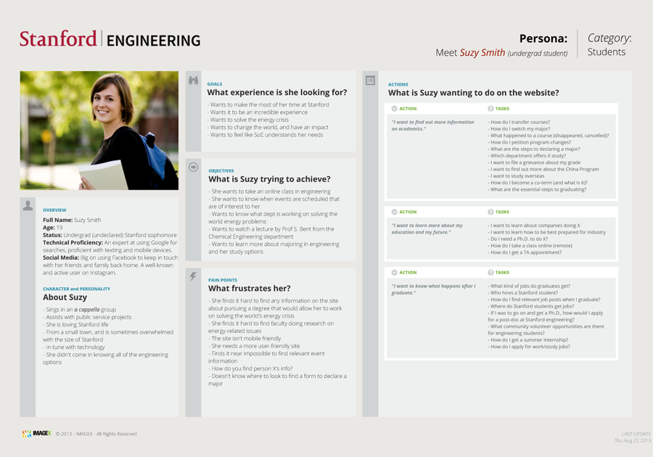
Case Study - Stanford
User Experience Design Activities…
Notes:
CONTENT 1 – A sample for the content page

Slide 34
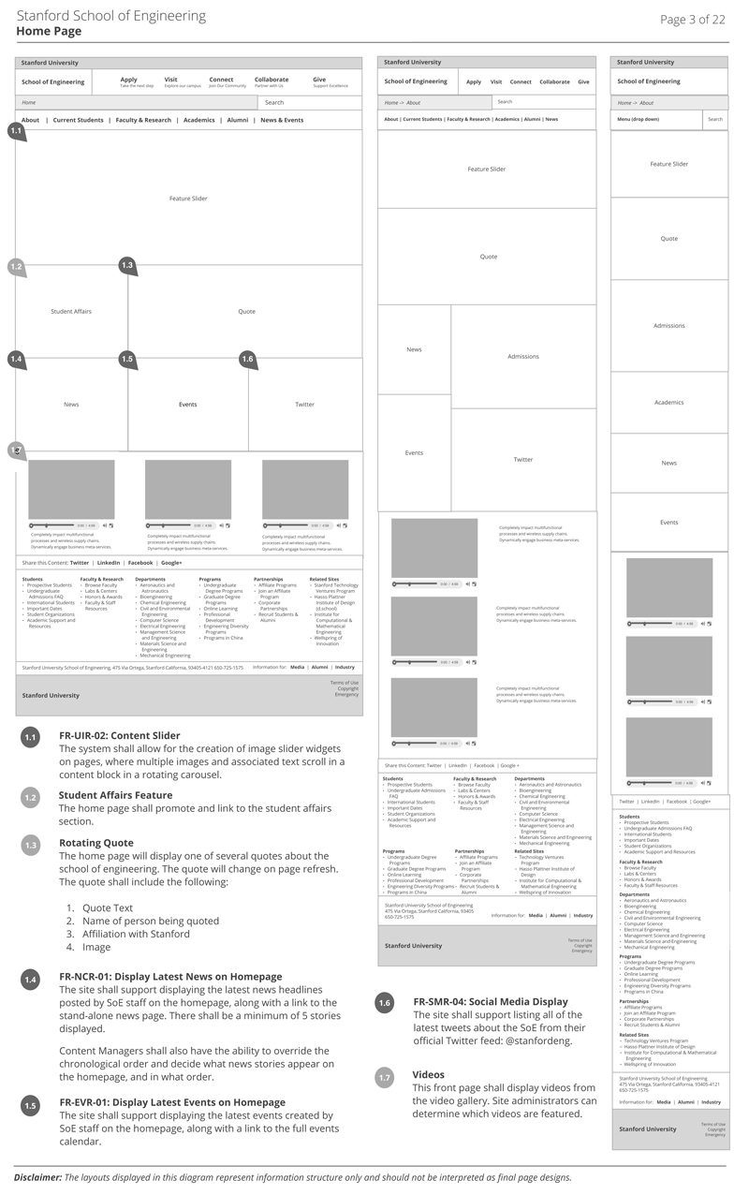
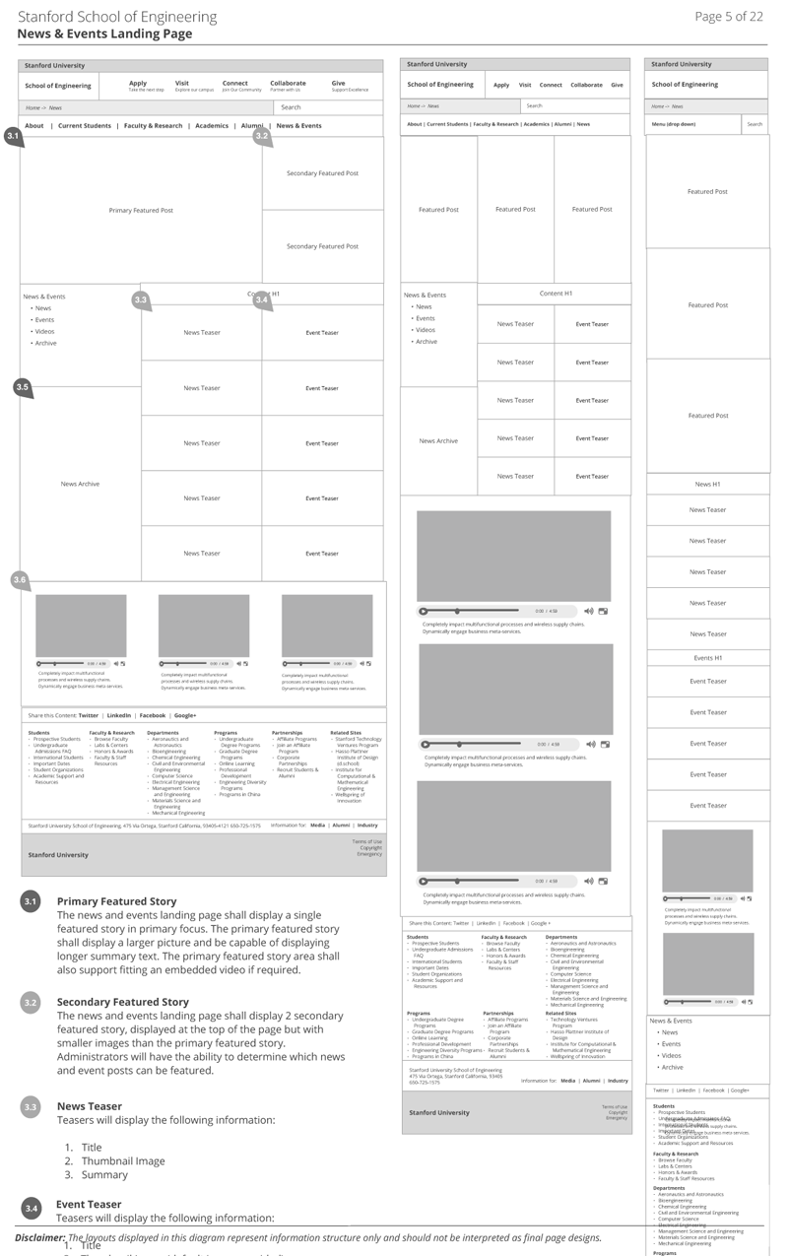
Case Study - Stanford
Wireframing Activities…
Notes:
CONTENT 1 – A sample for the content page

Slide 35
Case Study - Stanford
Into Development… Going Agile…
Stanford Team ImageX Team
Key Stakeholders Product Owner | Internal Product Owner Scrum Master Development Team
Functional Requirements
Epics & User Stories
User Requirements
Notes:
CONTENT 1 – A sample for the content page

Slide 36
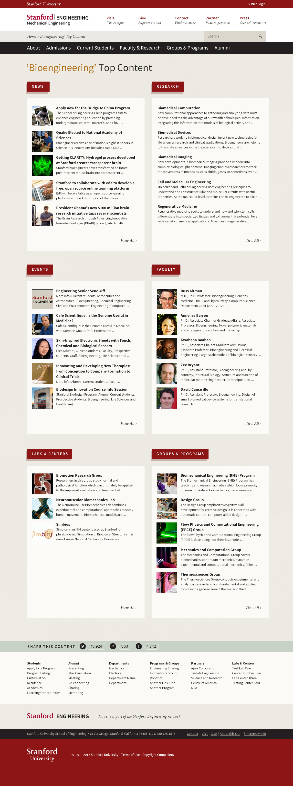
Case Study - Stanford
Scrum Activities…
User Story:
“As a Stanford student I want to easily find information about bioengineering so that I can stay informed about the latest developments in this field”
Notes:
CONTENT 1 – A sample for the content page

Slide 37

Thank You!
Any Questions?
@Adrian_D_Jones
adrian@imagexmedia.com
Notes:
COVER 1 – A sample for the cover

Slide 38
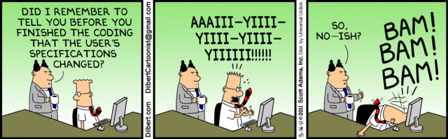
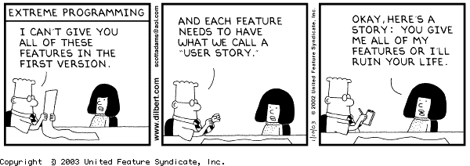
Notes:
CONTENT 1 – A sample for the content page

